Slide 1


Detecting Fake Health News
- Vaccines
By
Mohammed Rehan
Phil Greene
Sheethal Sridhar
Shubham Puri

Slide 2
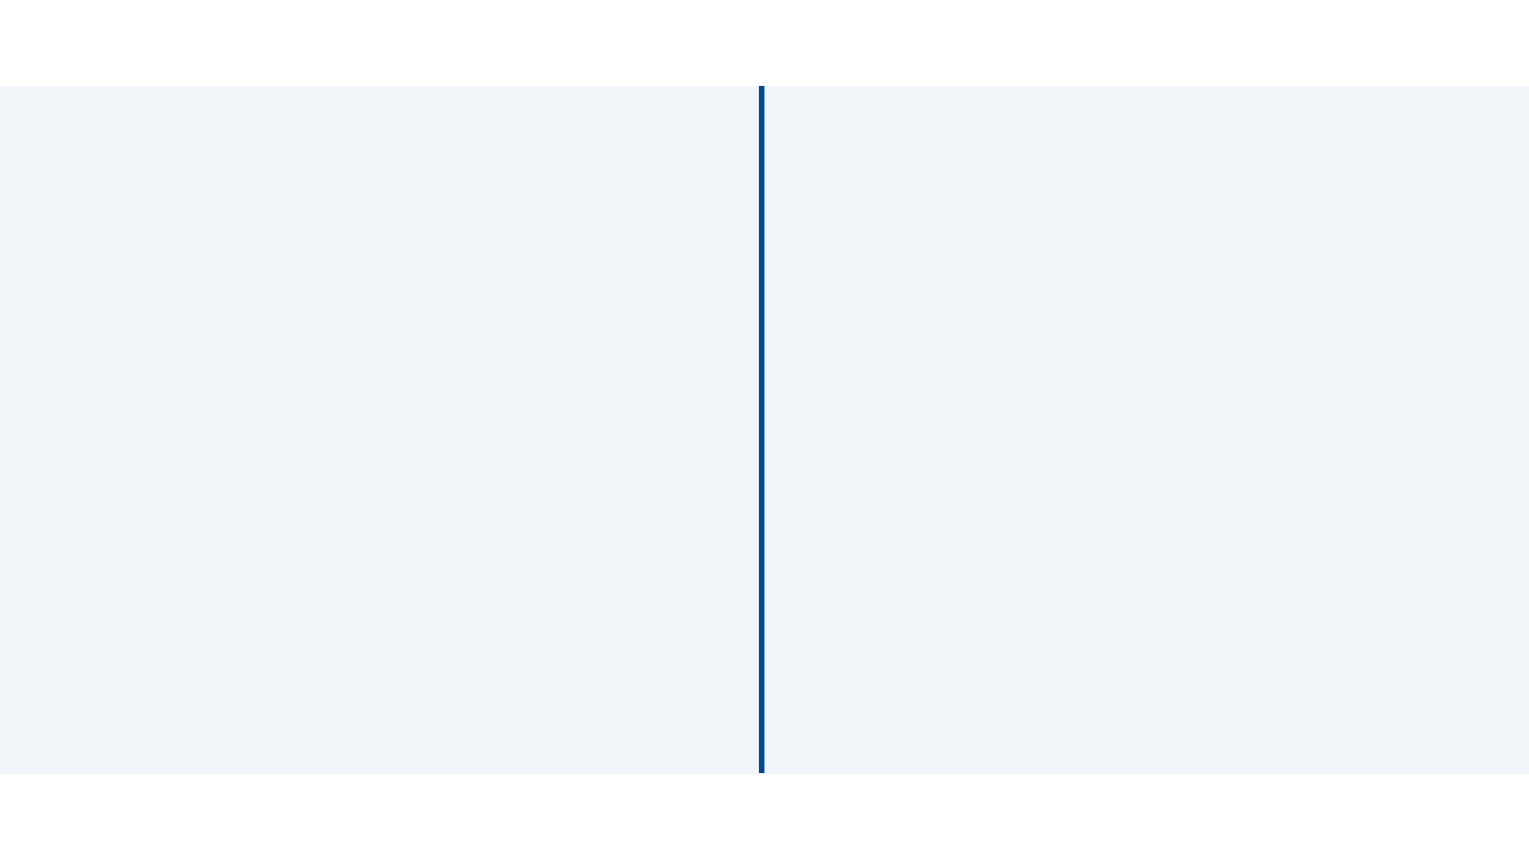

Contents
Current Scenario
Objective
Process
Tools used
Data gathering
Data Description
Fact Repository
Classification
Data Cleaning
Modelling
Analysis

Slide 3


Current Scenario
False news reaches more people than the truth
Motivations of its creators vary, but fake medical news can earn clicks and “likes,” which can translate to ad revenue, or further become an agenda for large-scale investments
False information can also drive the sale of expensive, unproven treatments
Unproven remedies may be harmful, waste money and sometimes, using these remedies keeps people from getting the medical treatment they need

Slide 4

Objective
Detect fake tweets about ‘vaccines’ using Machine Learning models
Analyzing the fake tweet characteristics

Slide 5

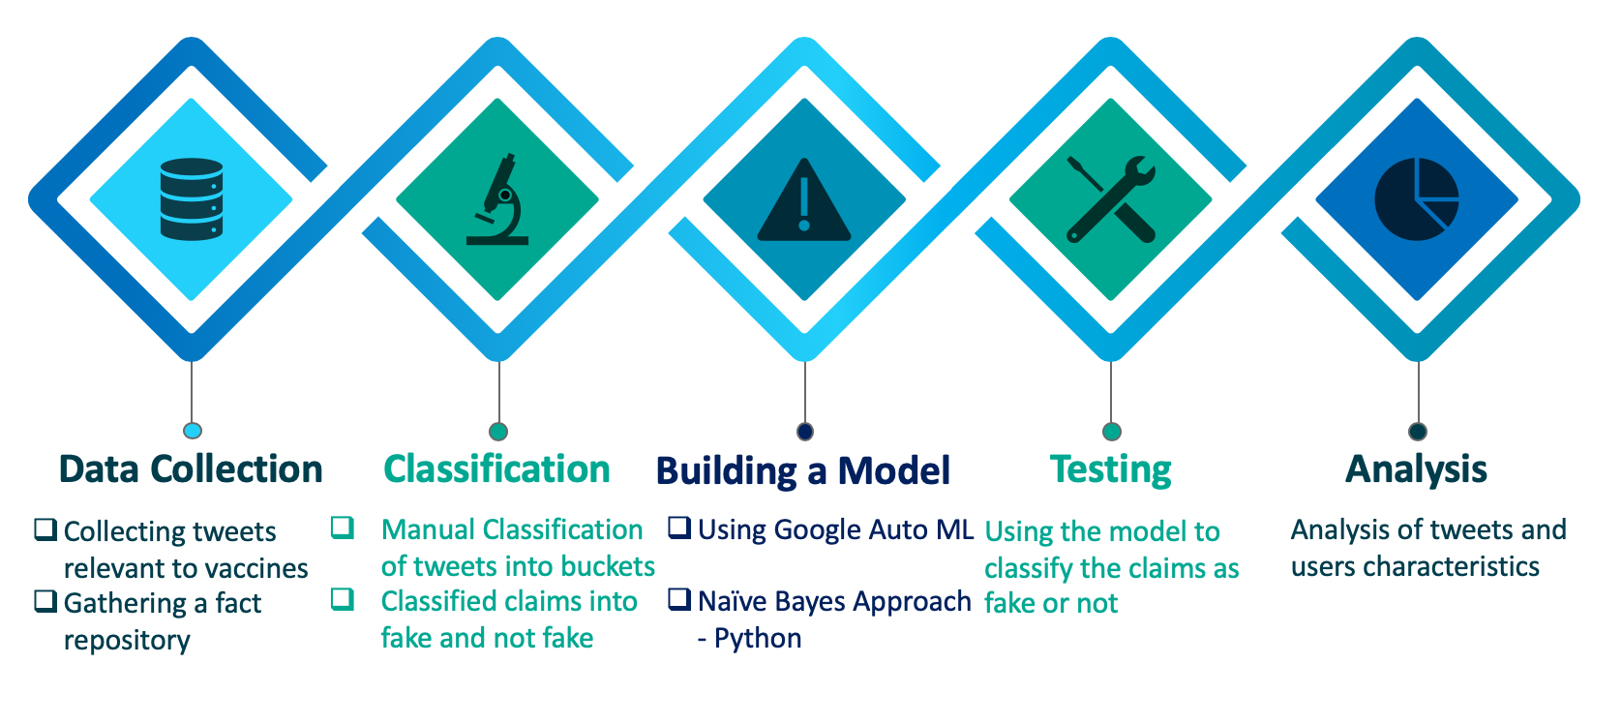
Process

Slide 6




Tools Used

Slide 7

Data Gathering
Used twitter API to collect tweets in R
Collected tweets containing word vaccines and hashtag vaccines for the period of 4 weeks
(keywords: "vaccines", "#vaccines"," Vaccines", "#Vaccines")
Gathered 20000 tweets, after removal of duplicates we were left with 18209 tweets

Slide 8
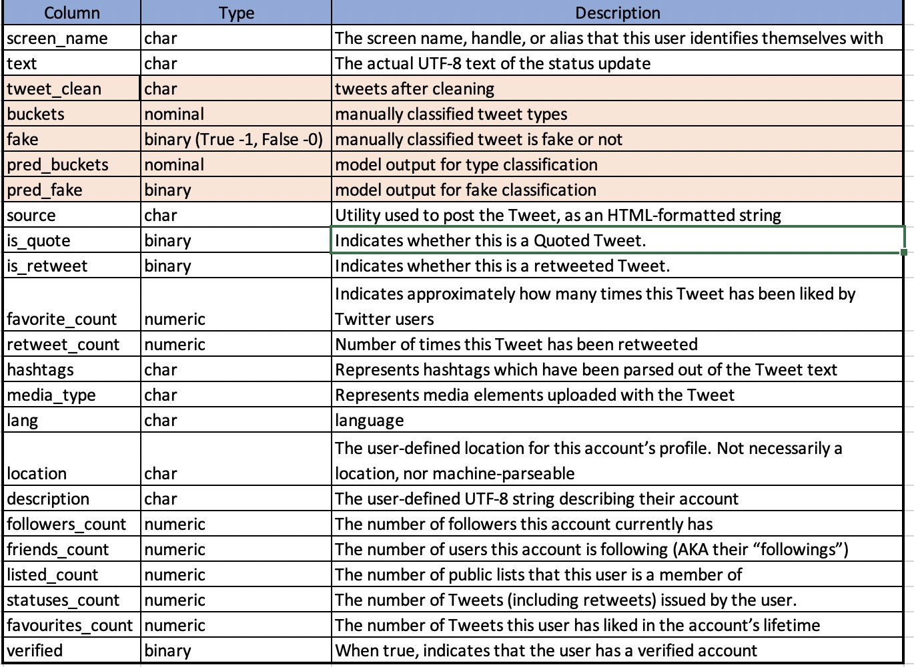
Data Description

Slide 9






Facts Repository
Analyzed multiple sources to gather a fact repository of vaccines
There were 16 most prominent myths among all the sources referred regarding vaccines
Our major sources for facts were from:

Slide 10
Facts Repository
Overview
Myth | Fact
Vaccines cause autism | Symptoms of autism in children develop well before they receive the MMR vaccine
Infant immune systems can’t handle so many vaccines | A baby would theoretically have the ability to respond to around 10,000 vaccines at one time
Natural immunity is better than vaccine-acquired immunity | Vaccine acquired immunity is more efficient than natural immunity
Vaccines contain unsafe toxins | Trace amounts of these chemicals are used in FDA approved vaccines hence safe
Better hygiene and sanitation are actually responsible for decreased infections, not vaccines | The effect of vaccines on curing diseases outweighs sanitation and hygiene
Vaccines aren’t worth the risk | The overall incidence rate of severe allergic reaction to vaccines is usually placed around one case for every one or two million injections.
Vaccines have several damaging and long-term side-effects that are yet unknown. Vaccination can even be fatal. | Vaccines are very safe. Before a vaccine is approved for public use, it is tested thoroughly for many years. Even after vaccines have been approved for the public, vaccines continue to be monitored
Vaccines can infect my child with the disease it’s trying to prevent | The vaccine recipients are experiencing a body’s immune response to the vaccine, not the disease itself

Slide 11

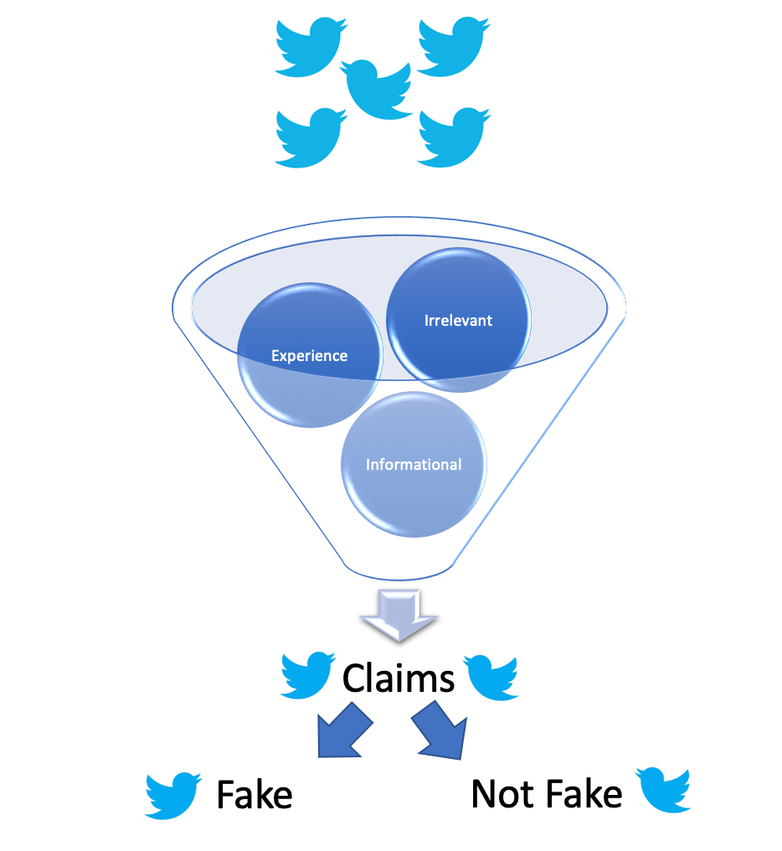
Classification Approach
Input

Slide 12
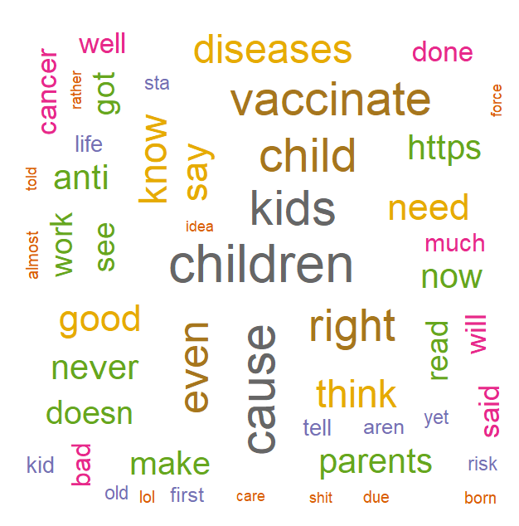
Manual Classification of Tweets
- Buckets
Classified the tweets into 4 different buckets
The different buckets are: Claims, Experience, Informational, Irrelevant
Claim - assertions about vaccines and its effectiveness
Experience - testimonials
Informational - news regarding vaccination
Irrelevant - none of the above types
Examples:
very happy to donate during our first #MaxFunDrive! It feels right to thank the good good boys and the rest of the McElroys for hours of laughs, and some tears And as an almost pharmacist I love @Sawbones and vaccines - experience
The #ImmunizeTexas Rally Day is one month away! Will you be there to speak up for #vaccines and fight for science? Visit our website to learn more (link in profile)! #TXLege #VaccinesWork #VaccinesCauseAdults #TIPDay19 - informational
A large new study finds kids who got no childhood vaccines were more likely to be diagnosed with autism than kids who did get recommended vaccinations.- claim
Sul pullman hanno messo ‚All my friends are falling in love‚ dei The Vaccines. CAN U HEAR ME SCREAMING - irrelevant
Notes:
2200 tweets classified manually

Slide 13
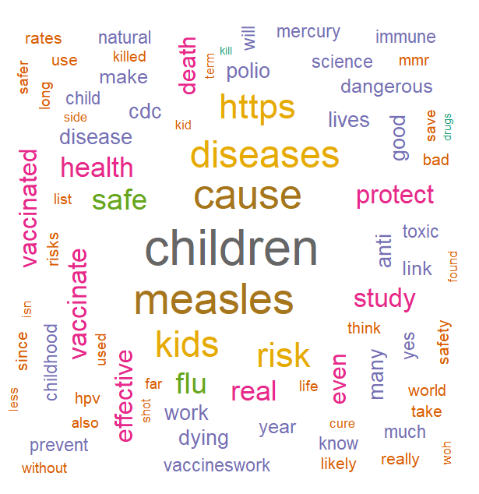
Manual Classification of Tweets
- Fake or not
Initially, we manually classified 1000 Tweets into 4 buckets: “Experience”, “Informational”, “Claims”, and “Irrelevant.”
We created a model with predictions for the next 500 and used a snowballing technique to ensure those classifications were accurate. We continued that process until 2000 tweets were classified into those 4 buckets.
All the tweets that were classified as claims (452) were then classified as Fake or Not Fake using our fact repository.

Slide 14
Data Cleaning
Original Tweet- @JohnHard3 @VirginiaInCal @truthglow @GrainOfSands Glyphosate Found in Childhood Vaccines .... The detection of glyphosate in vaccines ... would indicate the presence of other co-formulants which are also toxic .... Moms Across America sent a letter ... requesting that ....
Changed to lowercase
@johnhard3 @virginiaincal @truthglow @grainofsands glyphosate found in childhood vaccines .... the detection of glyphosate in vaccines ... would indicate the presence of other co-formulants which are also toxic .... moms across america sent a letter ... requesting that ....
Removed usernames
glyphosate found in childhood vaccines .... the detection of glyphosate in vaccines ... would indicate the presence of other co-formulants which are also toxic .... moms across america sent a letter ... requesting that ....
Removed all special characters and numbers
glyphosate found in childhood vaccines the detection of glyphosate in vaccines would indicate the presence of other coformulants which are also toxic moms across america sent a letter requesting that
Removed all stopwords
glyphosate found childhood vaccines detection glyphosate vaccines indicate presence coformulants also toxic moms across america sent letter requesting

Slide 15
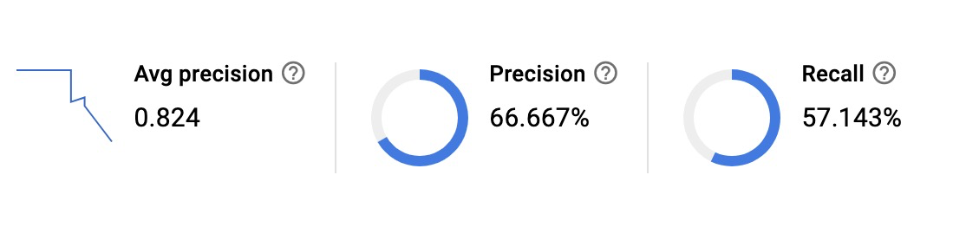
Building Model
Buckets
(Natural Language: Google cloud)
Built a model on Google cloud AI platform - AutoML Natural Language
Training data set consists of 1000 manually classified tweets into 4 buckets
Used the created model API to classify our remaining tweets into buckets
Model score:

Slide 16
Building Model
Fake/Not Fake
(Naive Bayes Python)
All tweets labeled “Claims” were used to train the model to predict all unlabeled “Claims” in the Dataset
The Model used Count Vectorized words as the features and labeled 1 for Fake and 0 for Not Fake.
Labeled Data was split 80/20 for cross validation
Naive Bayes Model was used on the vectorized words
Accuracy: 77% Precision: 81% Recall: 88% F1 Score: 85%
(True = Positive Class)

Slide 17
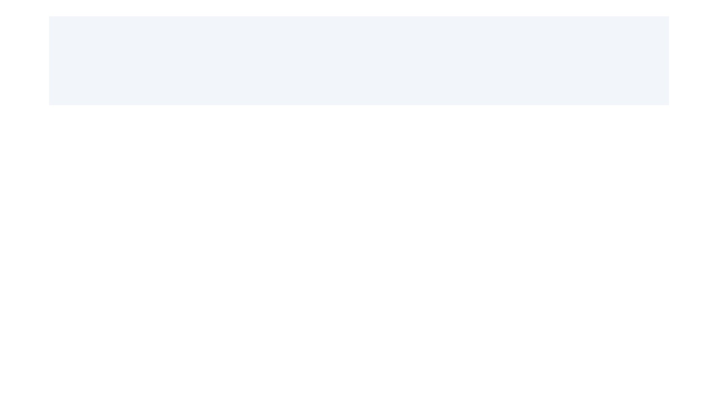
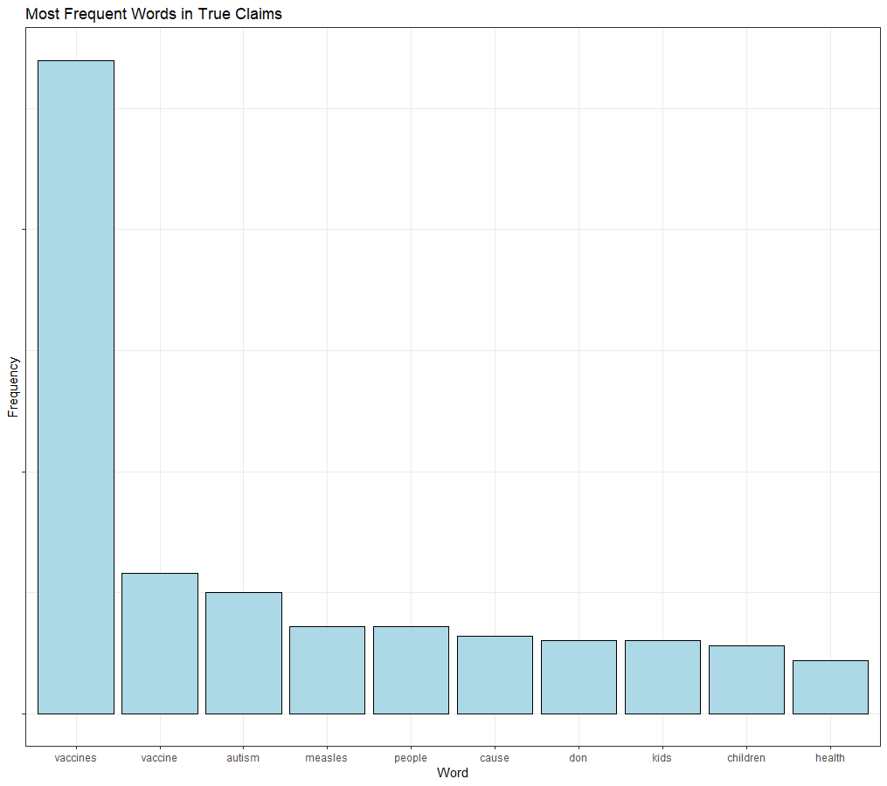
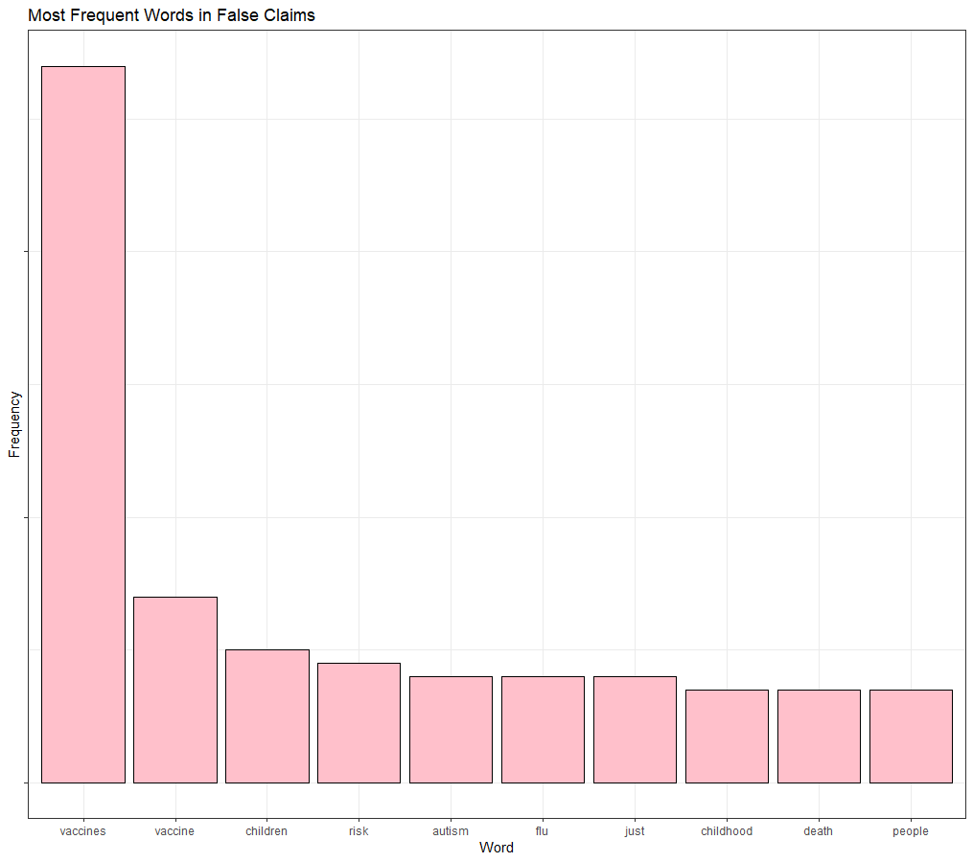
Training Data Word Analysis

Slide 18
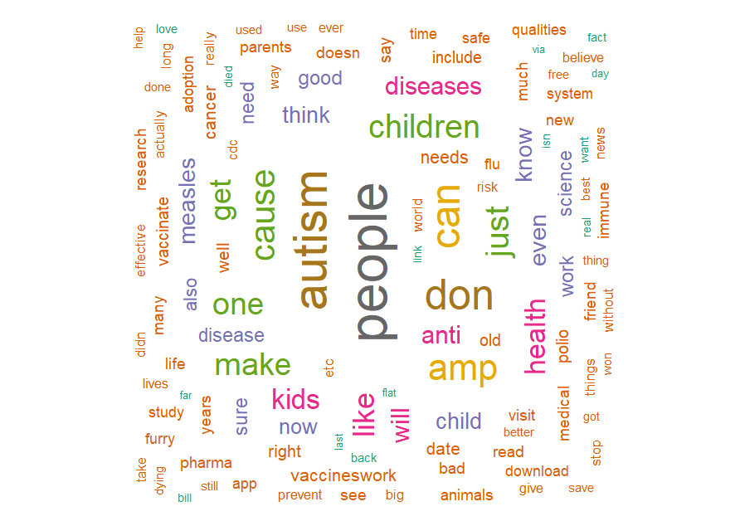
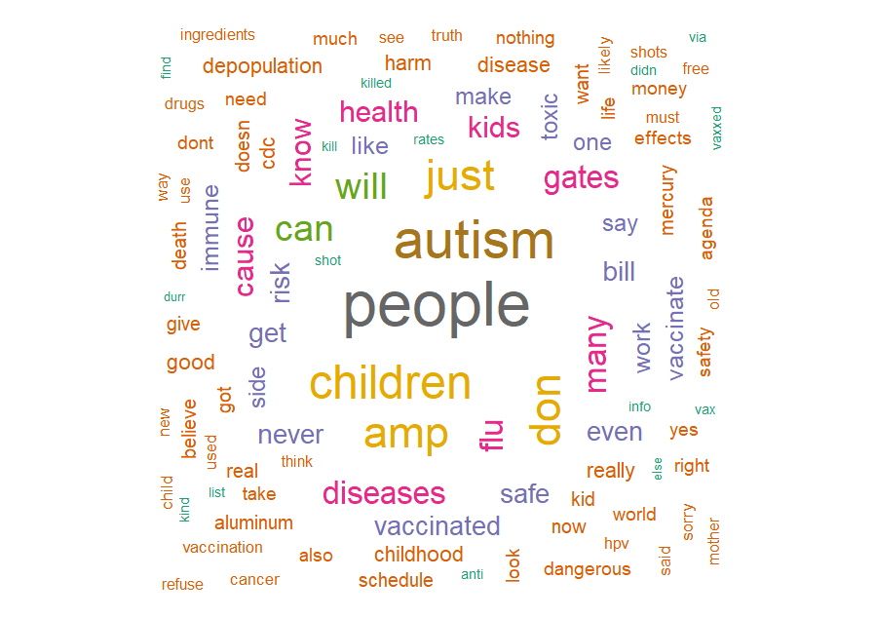
Word Clouds
True Claims in the Training Data (1000 Tweets)
False Claims in the Training Data (1000 Tweets)
Notes:
Aggressive attention grabbing words often used in False claims.

Slide 19
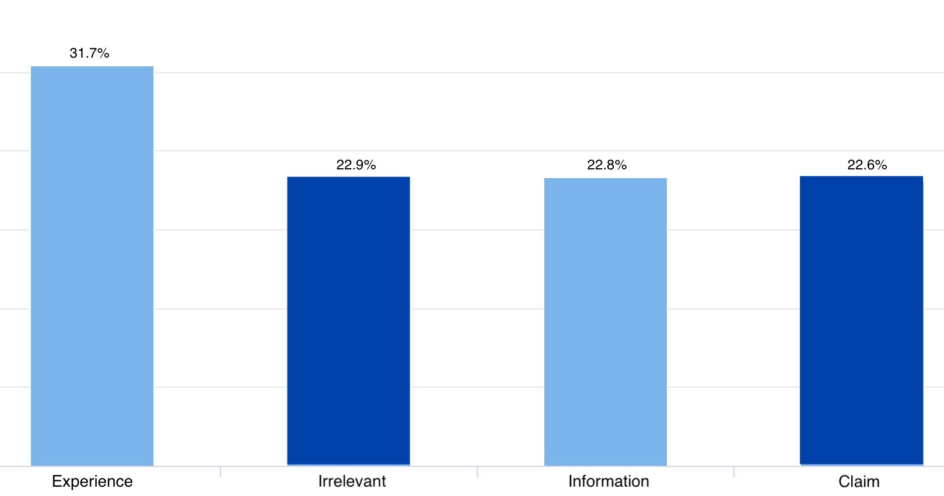
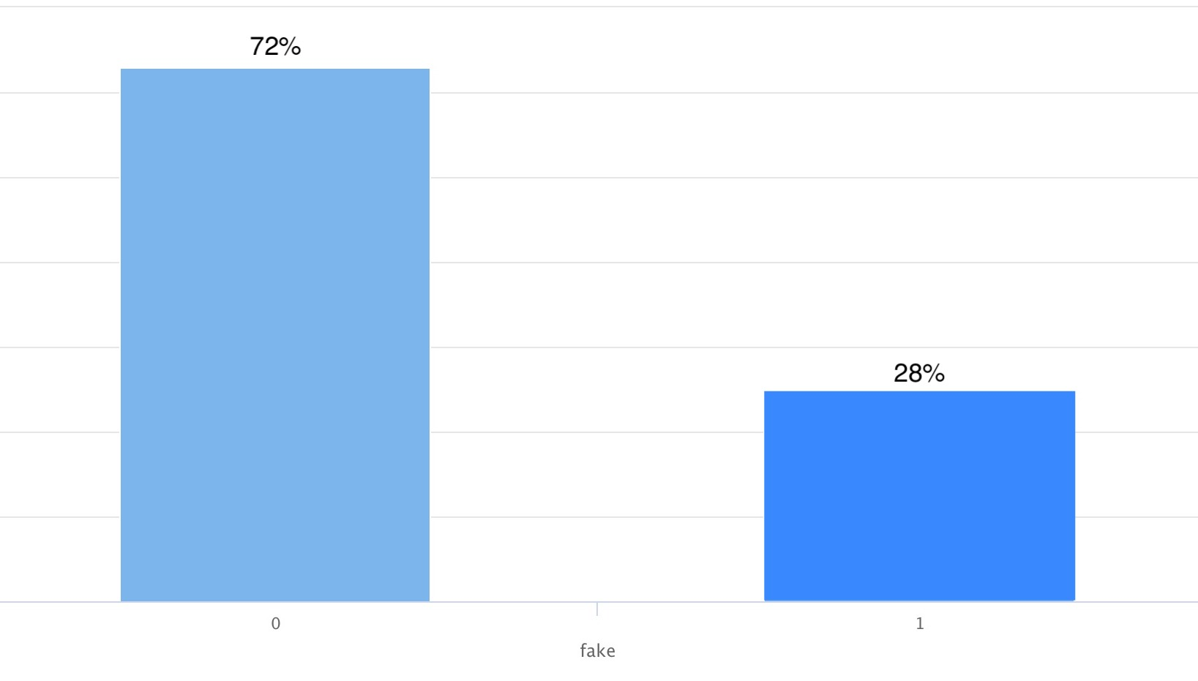
Analysis - Distribution
326 Tweets
634 Tweets
Total: 2000 tweets
Total: 452 tweets
458 Tweets
456 Tweets
452 Tweets
126 Tweets
Not Fake
Fake
Distribution of Buckets
Distribution of Fake in Claims

Slide 20
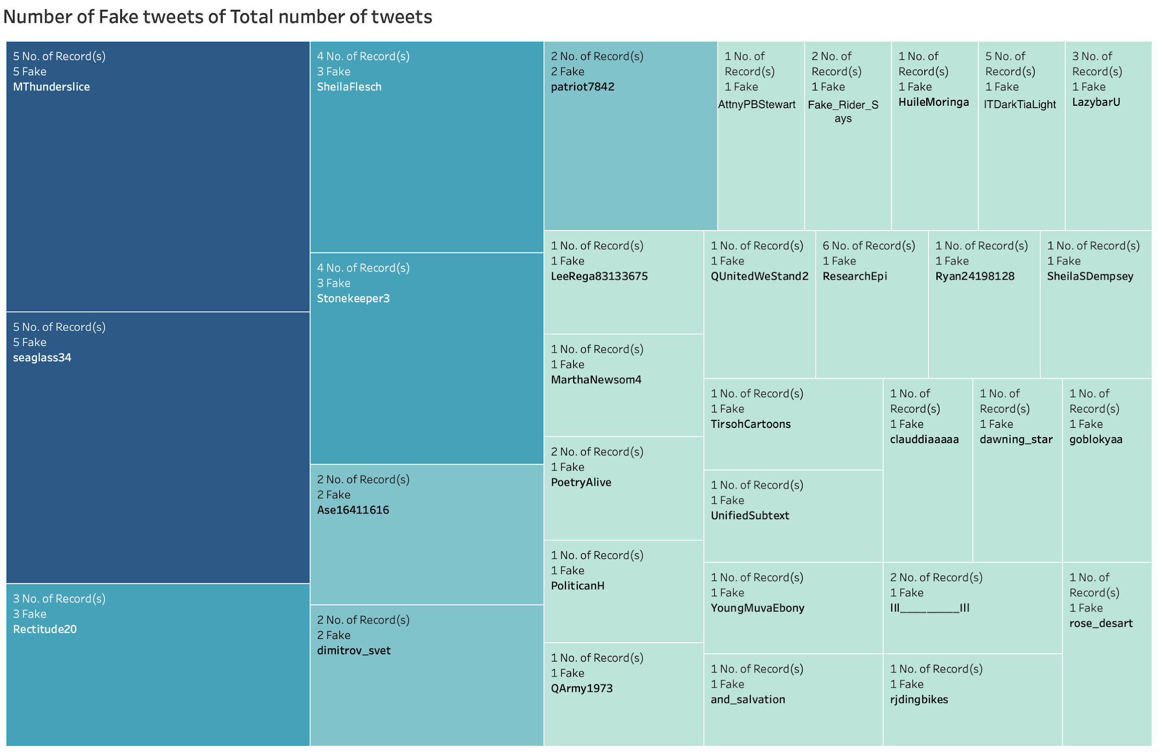
Analysis - Fake tweets/Total no. of tweets

Slide 21
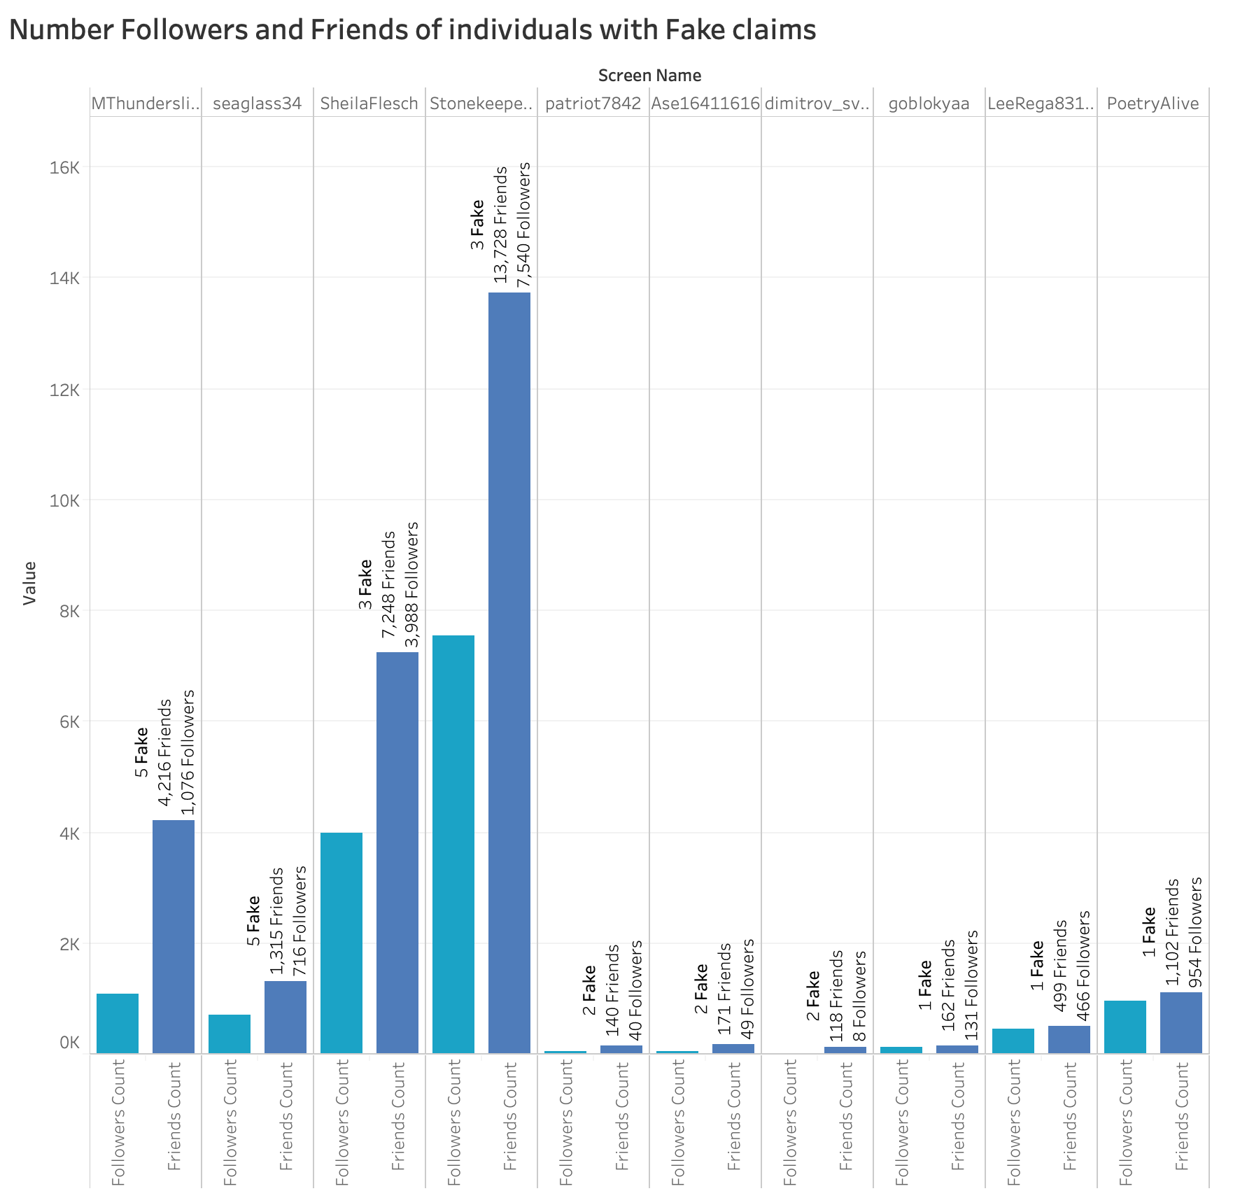
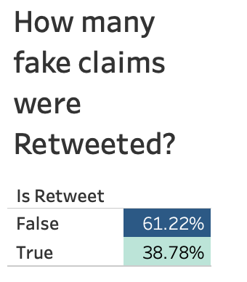
Analysis of Fake claims
False : 77 Tweets
True : 49 Tweets

Slide 22
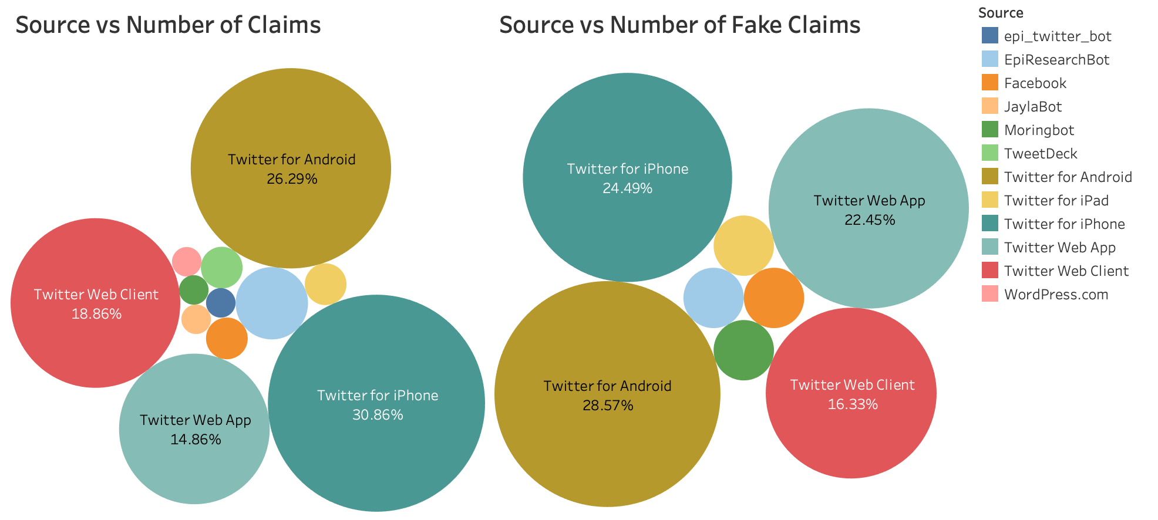
Analysis - Source of tweets
118 tweets
38 tweets
28 tweets
Others:: 43 tweets
85 tweets
36 tweets
20 tweets
67 tweets
139 tweets
Others:: 4 tweets

Slide 23
Result - snippet
Fake Claims
Example 1: not only are many vaccines filled with toxins but gardasil is dangerous unnecessary amp ineffective it has not decreased cervical cancer but sure has harmed tens of thousands of the people you are supposed to protect
Example 2:a large new study finds kids who got no childhood vaccines were more likely to be diagnosed with autism than kids who did get recommended vaccinations
Non Fake Claims
Example 1:the hpv vaccine is most effective during adolescence when the body produces more antibodies against the virus thats why recommends the vaccine at ages 11 or 12
Example 2:modern vaccines are highly effective and safe they do not cause autism or contain toxic chemicals
Notes:
Fake Claims snapshot

Slide 24
Thank You

